Slide 1

Smart Farmer Market Assistant
System
A Hardware Solution for Price Transparency in Rural Markets
PRESENTED BY :
SOWMIYADHARSI S (922523106206)
DEPT OF ELECTRONICS AND COMMUNICATION ENGINEERING
VSB ENGINEERING COLLEGE , KARUR .
1

Slide 2

Introduction
Agriculture plays a major role in the rural economy.
However, many farmers face problems while selling their crops.
Key Issues:
Lack of real-time market price information
Dependence on middlemen
Low profit for farmers
Technology can help farmers make better selling decisions.
2

Slide 3

Problem Statement
Farmers often do not know the actual market price of their crops.
Problems faced:
Price opacity in rural markets
Farmers lose up to 30% profit
No easy system to calculate crop value
Lack of market comparison
3

Slide 4

Objective of the Project
The objective of this project is to develop a smart hardware device that:
Displays current crop market price
Measures crop weight automatically
Calculates total selling value
Receives price updates via SMS
Suggests the best market to sell crops
4

Slide 5

Proposed System
The proposed system is a Smart Farmer Market Assistant Device.
The device helps farmers by:
Providing price transparency
Calculating crop value instantly
Suggesting profitable markets
This improves farmer income and decision making.
5

Slide 6
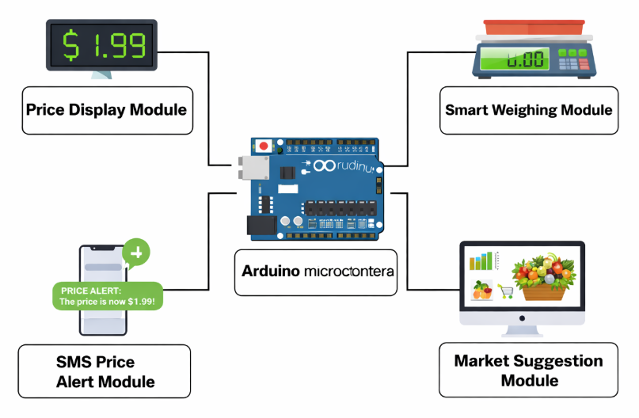
System Architecture
Main Parts of the System:
Price Display Module
Smart Weighing Module
SMS Price Alert Module
Market Suggestion Module
All modules are controlled by Arduino microcontroller.
6

Slide 7
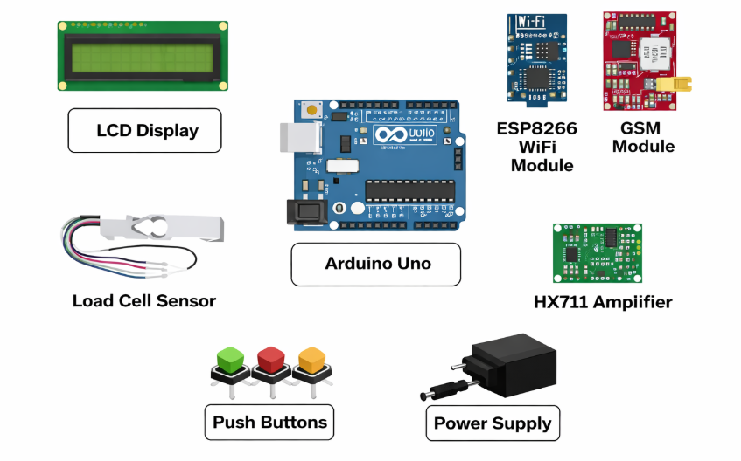
Hardware Components
Main components used:
Arduino Uno
LCD Display
ESP8266 WiFi Module
GSM Module
Load Cell Sensor
HX711 Amplifier
Push Buttons
Power Supply
These components form the core hardware system.
7

Slide 8
Working Principle
Market price is received through WiFi or SMS.
The price is displayed on the LCD screen.
The farmer selects the crop using buttons.
Crop is placed on load cell sensor.
Arduino calculates weight × price.
System suggests the best market to sell.
8

Slide 9
Advantages
Helps farmers know accurate market prices
Reduces dependency on middlemen
Instant price calculation
Low cost hardware solution
Easy to use in rural areas
Applications
This system can be used in:
Rural farming villages
Agricultural markets
Farmer cooperatives
Government agriculture support centers
Smart farming projects
9

Slide 10
Conclusion
The Smart Farmer Market Assistant System helps farmers access accurate market prices and calculate crop value easily.
This system:
Improves price transparency
Increases farmer profit
Reduces middlemen exploitation
It is a low-cost and practical solution for rural farmers.
10

